Slide 1
C# Async-Await Pattern Mejoras Prácticas
Robert Rozas Navarro
https://stackoverflow.com/users/1987838/hackerman
https://github.com/AshWilliams

Slide 2
Agenda
El Qué & Porqué de Async
Async Control Flow
Todo es una Task
Library Thinking
Problemas Comunes
…but really whatever you want to talk about…

Slide 3
The What & Why of Async

Slide 4
What does asynchrony really mean?
Synchronous
Perform something here and now.
I’ll regain control to execute something else when it’s done.
Asynchronous
Initiate something here and now.
I’ll regain control to execute something else “immediately”.
How an operation is invoked
implies nothing about the
implementation of the workload itself.

Slide 5
Sync vs Async
“Pause for 10 seconds, then output 'Hello' to the console.”
Synchronous
Asynchronous
public static void PausePrintAsync() { ThreadPool.QueueUserWorkItem(_ => PausePrint()); }
public static void PausePrint() { var end = DateTime.Now + TimeSpan.FromSeconds(10); while(DateTime.Now < end); Console.WriteLine("Hello"); }
public static async Task PausePrintAsync() { return Task.Run(() => PausePrint()); }
“async over sync”
public static void PausePrint() { Task t = PausePrintAsync(); t.Wait(); }
public static Task PausePrintAsync() { var tcs = new TaskCompletionSource<bool>(); new Timer(_ => { Console.WriteLine("Hello"); tcs.SetResult(true); }).Change(10000, Timeout.Infinite); return tcs.Task; }
public static async Task PausePrintAsync() { await Task.Delay(10000); Console.WriteLine("Hello"); }
“sync over async”
Both “async over sync” and “sync over async” can be problematic
if you don’t completely understand the implementation.

Slide 6
Why go async?
Offloading
Avoid tying up the current thread (some threads matter more than others)
Do work on a specific thread (some threads are more capable than others)
Concurrency
Start multiple operations so that they may process concurrently
Scalability
Don’t waste resources (i.e. threads) you don’t need to use
“async over sync” often valuable
Task.Run
Parallel.*
“async over sync” not useful, potentially damaging
Async I/O
async/await are not about “going async.” They’re about “composing async.”

Slide 7
Async Control Flow

Slide 8
Problem with async void
private async void Button1_Click(object Sender, EventArgs e) {
try {
SendData("https://secure.flickr.com/services/oauth/request_token");
await Task.Delay(2000);
DebugPrint("Received Data: " + m_GetResponse);
}
catch (Exception ex) {
rootPage.NotifyUser("Error posting data to server." + ex.Message);
}
}
private async void SendData(string Url) {
var request = WebRequest.Create(Url);
using (var response = await request.GetResponseAsync())
using (var stream = new StreamReader(response.GetResponseStream()))
m_GetResponse = stream.ReadToEnd();
}

Slide 9
Problem with async void
private async void Button1_Click(object Sender, EventArgs e) {
try {
SendData("https://secure.flickr.com/services/oauth/request_token");
// await Task.Delay(2000);
// DebugPrint("Received Data: " + m_GetResponse);
}
catch (Exception ex) {
rootPage.NotifyUser("Error posting data to server." + ex.Message);
}
}
private async void SendData(string Url) {
var request = WebRequest.Create(Url);
using (var response = await request.GetResponseAsync()) // exception on resumption
using (var stream = new StreamReader(response.GetResponseStream()))
m_GetResponse = stream.ReadToEnd();
}

Slide 10
For goodness’ sake stop using async void

Slide 11
Async void is only for event handlers
Principles
Async void is a “fire-and-forget” mechanism...
The caller is unable to know when an async void has finished
The caller is unable to catch exceptions thrown from an async void
(instead they get posted to the UI message-loop)
Guidance
Use async void methods only for top-level event handlers (and their like)
Use async Task-returning methods everywhere else
When you see an async lambda, verify it

Slide 12
Passing Task around
private async void Button1_Click(object Sender, EventArgs e) {
try {
SendData("https://secure.flickr.com/services/oauth/request_token");
await Task.Delay(2000);
DebugPrint("Received Data: " + m_GetResponse);
}
catch (Exception ex) {
rootPage.NotifyUser("Error posting data to server." + ex.Message);
}
}
private async void SendData(string Url) {
var request = WebRequest.Create(Url);
using (var response = await request.GetResponseAsync())
using (var stream = new StreamReader(response.GetResponseStream()))
m_GetResponse = stream.ReadToEnd();
}
Async
await
Task
Async

Slide 13
Problem with async void v2
// Q. It sometimes shows PixelWidth and PixelHeight are both 0 ???
BitmapImage m_bmp;
protected override async void OnNavigatedTo(NavigationEventArgs e) {
base.OnNavigatedTo(e);
await PlayIntroSoundAsync();
image1.Source = m_bmp;
Canvas.SetLeft(image1, Window.Current.Bounds.Width - m_bmp.PixelWidth);
}
protected override async void LoadState(Object nav, Dictionary<String, Object> pageState) {
m_bmp = new BitmapImage();
var file = await StorageFile.GetFileFromApplicationUriAsync("ms-appx:///pic.png");
using (var stream = await file.OpenReadAsync()) {
await m_bmp.SetSourceAsync(stream);
}
}
class LayoutAwarePage : Page
{
private string _pageKey;
protected override void OnNavigatedTo(NavigationEventArgs e)
{
if (this._pageKey != null) return;
this._pageKey = "Page-" + this.Frame.BackStackDepth;
...
this.LoadState(e.Parameter, null);
}
}

Slide 14
Passing Task around
// A. Use a task
Task<BitmapImage> m_bmpTask;
protected override async void OnNavigatedTo(NavigationEventArgs e) {
base.OnNavigatedTo(e);
await PlayIntroSoundAsync();
var bmp = await m_bmpTask; image1.Source = bmp;
Canvas.SetLeft(image1, Window.Current.Bounds.Width - bmp.PixelWidth);
}
protected override void LoadState(Object nav, Dictionary<String, Object> pageState) {
m_bmpTask = LoadBitmapAsync();
}
private async Task<BitmapImage> LoadBitmapAsync() {
var bmp = new BitmapImage();
...
return bmp;
}

Slide 15
Verify async lambdas
' In VB, the expression itself determines void- or Task-returning (not the context).
Dim void_returning = Async Sub()
Await LoadAsync() : m_Result = "done"
End Sub
Dim task_returning = Async Function()
Await LoadAsync() : m_Result = "done"
End Function
' If both overloads are offered, you must give it Task-returning.
Await Task.Run(Async Function() ... End Function)
// In C#, the context determines whether async lambda is void- or Task-returning.
Action a1 = async () => { await LoadAsync(); m_Result="done"; };
Func<Task> a2 = async () => { await LoadAsync(); m_Result="done"; };
// Q. Which one will it pick?
await Task.Run( async () => { await LoadAsync(); m_Result="done"; });
// A. If both overloads are offered, it will pick Task-returning. Good!
class Task
{
static public Task Run(Action a) {...}
static public Task Run(Func<Task> a) {...}
...
}

Slide 16
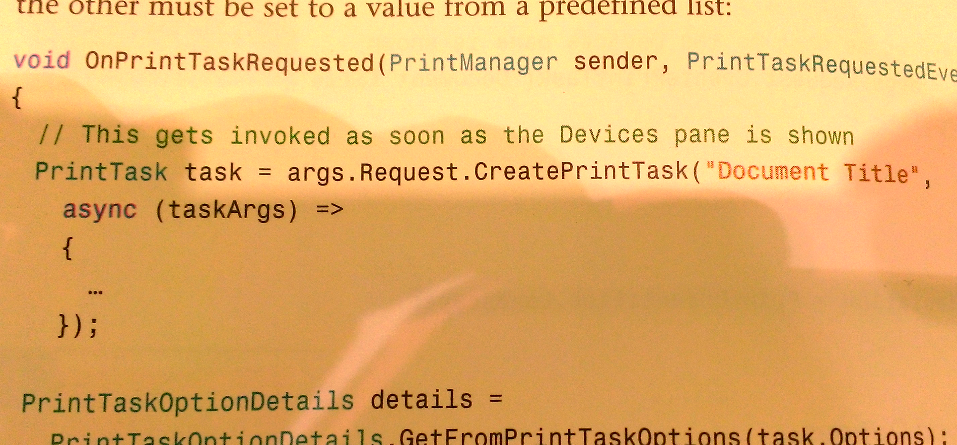
Verify async lambdas

Slide 17
Verify async lambdas
try {
await Dispatcher.RunAsync(CoreDispatcherPriority.Normal, async () => {
await LoadAsync();
m_Result = "done";
throw new Exception();
});
}
catch (Exception ex) {
}
finally {
DebugPrint(m_Result);
}
// IAsyncAction RunAsync(CoreDispatcherPriority priority, DispatchedHandler agileCallback);
// delegate void DispatchedHandler();
// We want a version of Dispatcher.Run that works with async lambdas...
await Dispatcher.NewRunAsync(CoreDispatcherPriority.Normal, async () => { ... });
// Here's one easy way to provide it...
public static async Task NewRunAsync(this CoreDispatcher dispatcher, Func<Task> f)
{
Task t = null;
await dispatcher.RunAsync(CoreDispatcherPriority.Normal, () => t = f());
await t;
// TODO: use ConfigureAwait(continueOnCapturedContext:false) on both my awaits
}

Slide 18
Async/await are not magic
// ORIGINAL CODE
async Task FooAsync()
{
BODY
}
// APPROXIMATELY WHAT THE COMPILER GENERATES...
Task FooAsync()
{
var sm = new FooAsyncStruct();
sm.tcs = new TaskCompletionSource();
sm.MoveNext();
return sm.tcs.Task;
}
struct FooAsyncStruct {
public TaskCompletionSource tcs;
private void MoveNext() {
try {
TRANSFORMED_BODY
}
catch (Exception ex) {
tcs.SetException(ex); return;
}
tcs.SetResult();
}
}

Slide 19
Async/await are not magic
// ORIGINAL CODE
var r = await t;
// APPROXIMATELY WHAT THE COMPILER GENERATES...
var tmp = t.GetAwaiter();
if (!tmp.IsCompleted) {
var ec = ExecutionContext.Capture()
((INotifyCompletion)tmp).OnCompleted(_ => ExecutionContext.Run(ec, K1));
return;
}
K1:
var r = tmp.GetResult();
// The two lines in italics are executed from within a routine inside mscorlib
// The argument "K1" represents a delegate that, when executed, resumes execution at the label.
// If "tmp" is a struct, any mutations after IsCompleted before GetResult may be lost.
// If tmp implements ICriticalNotifyCompletion, then it calls tmp.UnsafeOnCompleted instead.
// The variable "ec" gets disposed at the right time inside the lambda
// If ec is null, then it invokes K1 directly instead of via ExecutionContext.Run
// There are optimizations for the case where ExecutionContext is unmodified.

Slide 20
Everything as a Task

Slide 21
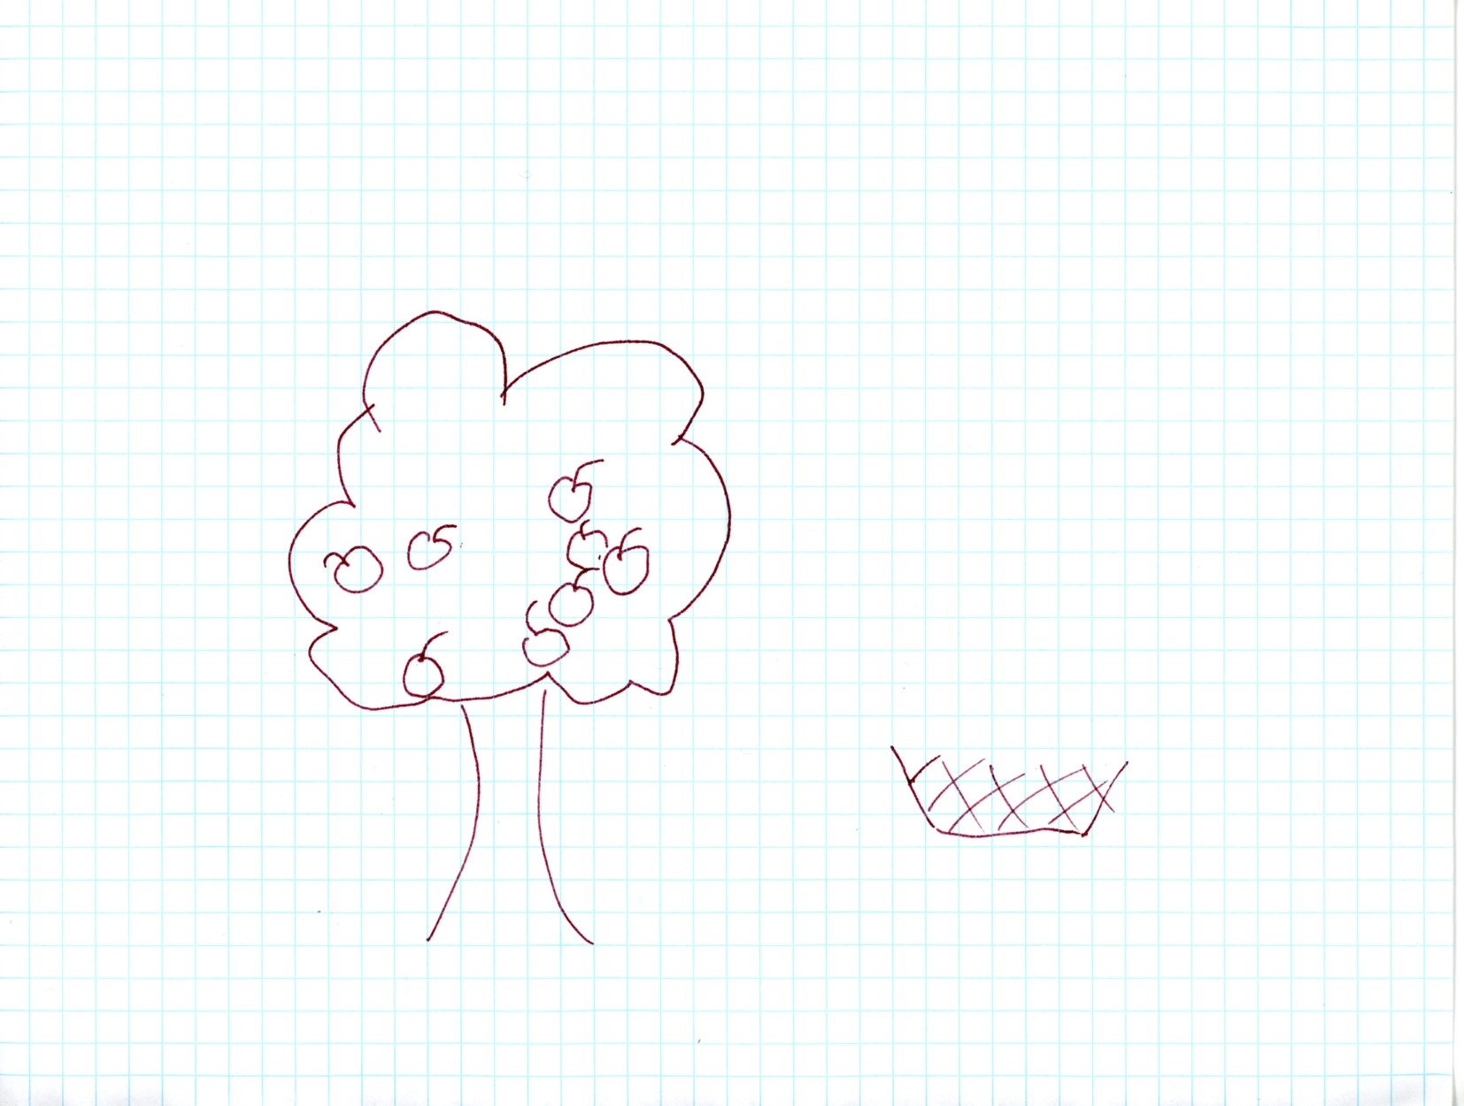
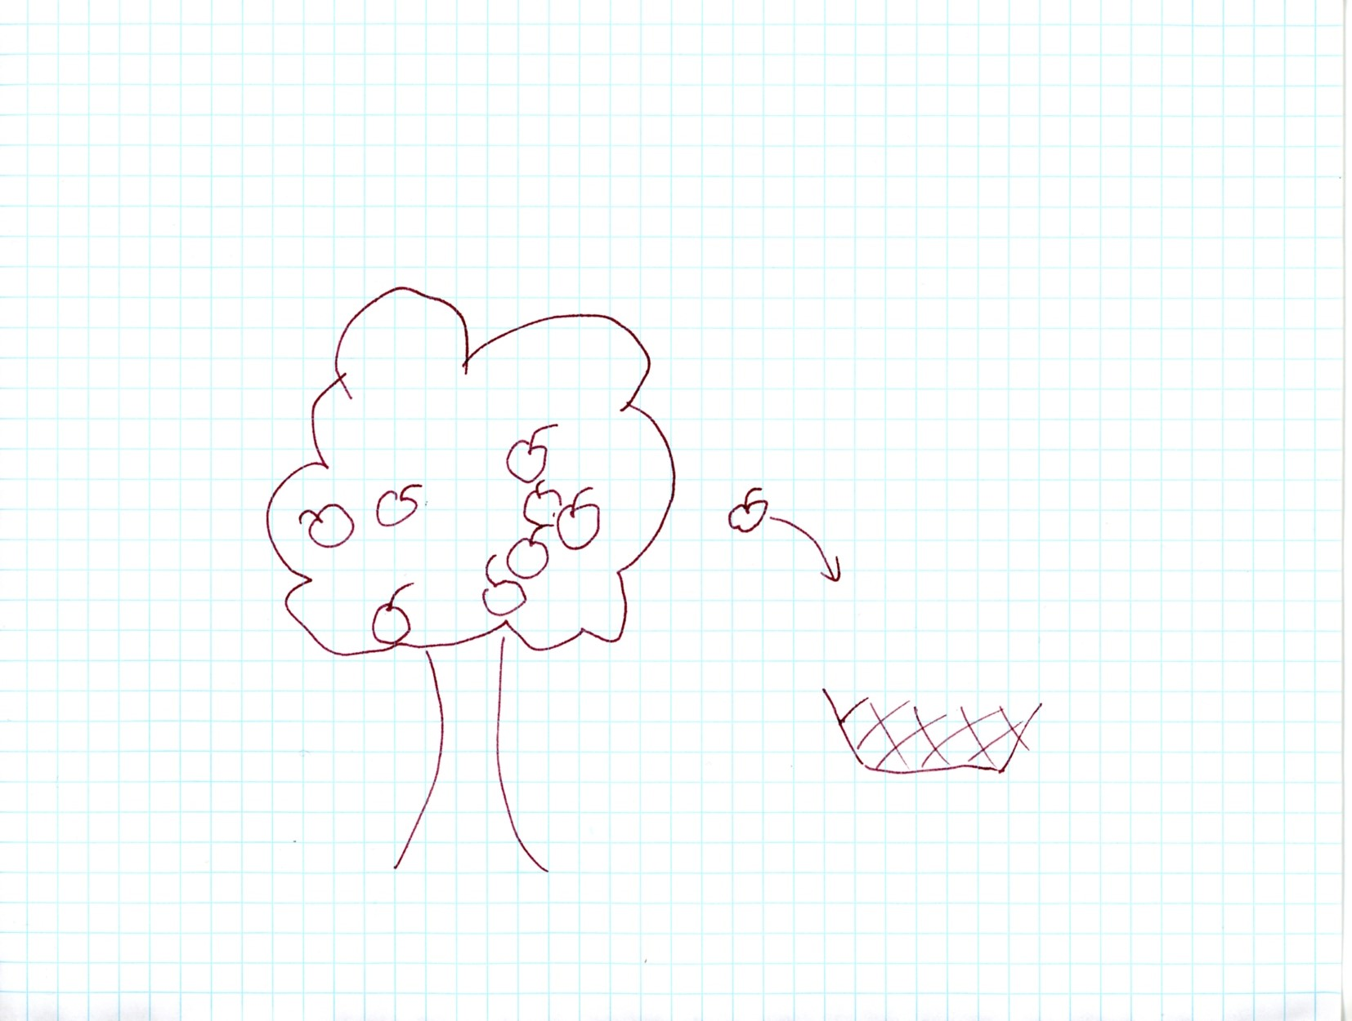
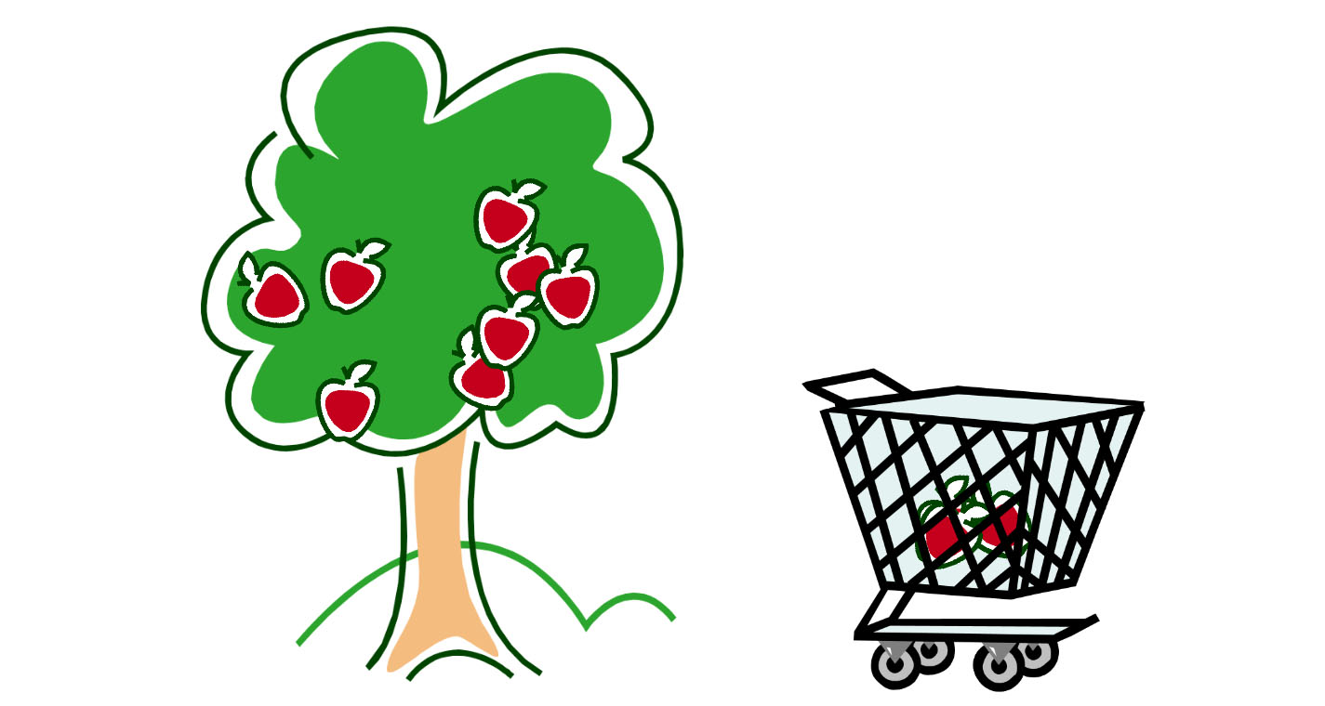
Event-based code...

Slide 22
Event-based code...
Protected Overrides Sub OnPointerPressed(e As PointerRoutedEventArgs)
Dim apple = CType(e.OriginalSource, Image)
AddHandler apple.PointerReleased,
Sub(s, e2)
Dim endpt = e2.GetCurrentPoint(Nothing).Position
If Not BasketCatchmentArea.Bounds.Contains(endpt) Then Return
Canvas.SetZIndex(apple, 1) ' mark apple as no longer free
If FreeApples.Count > 0 Then
m_ActionAfterAnimation = Sub()
WhooshSound.Stop()
ShowVictoryWindow()
AddHandler btnOk.Click, Sub()
....
End Sub
End Sub
End If
WhooshSound.Play()
AnimateThenDoAction(AppleIntoBasketStoryboard)

Slide 23
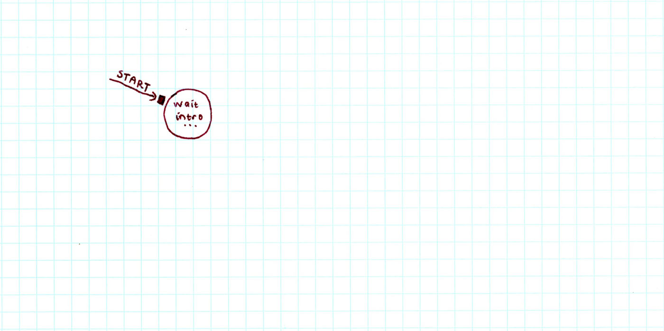

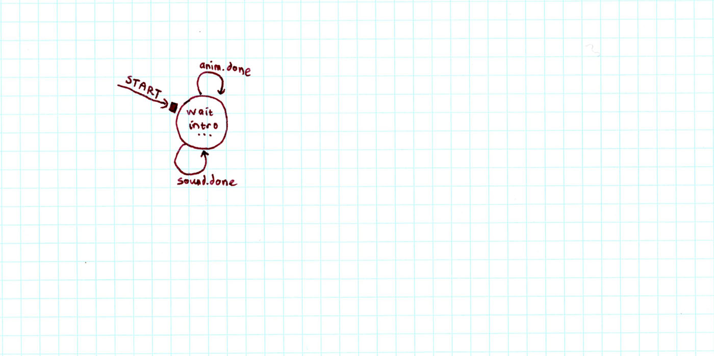
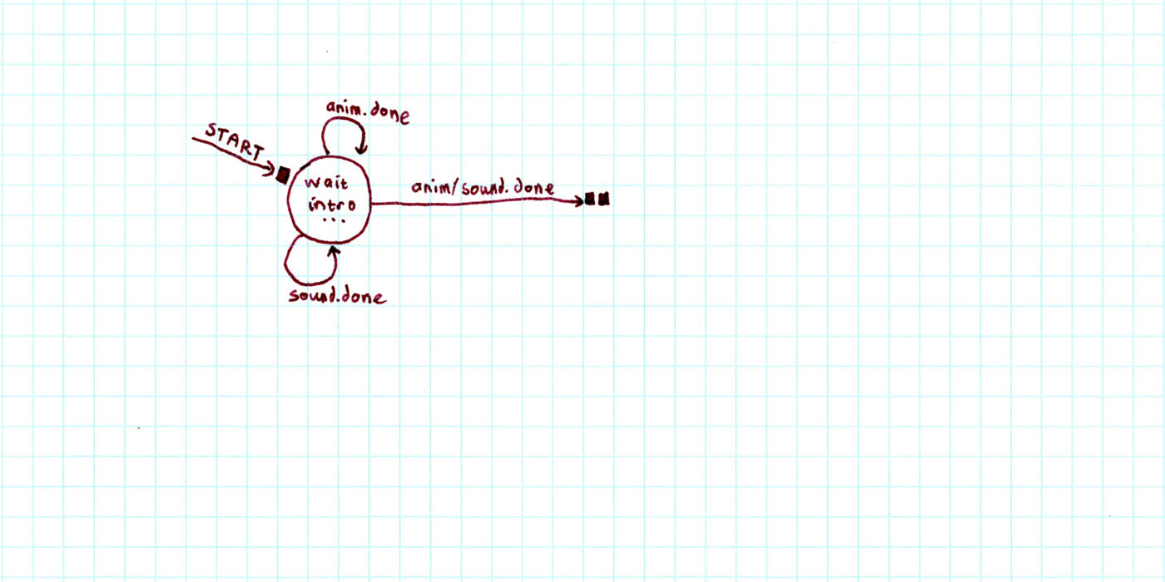
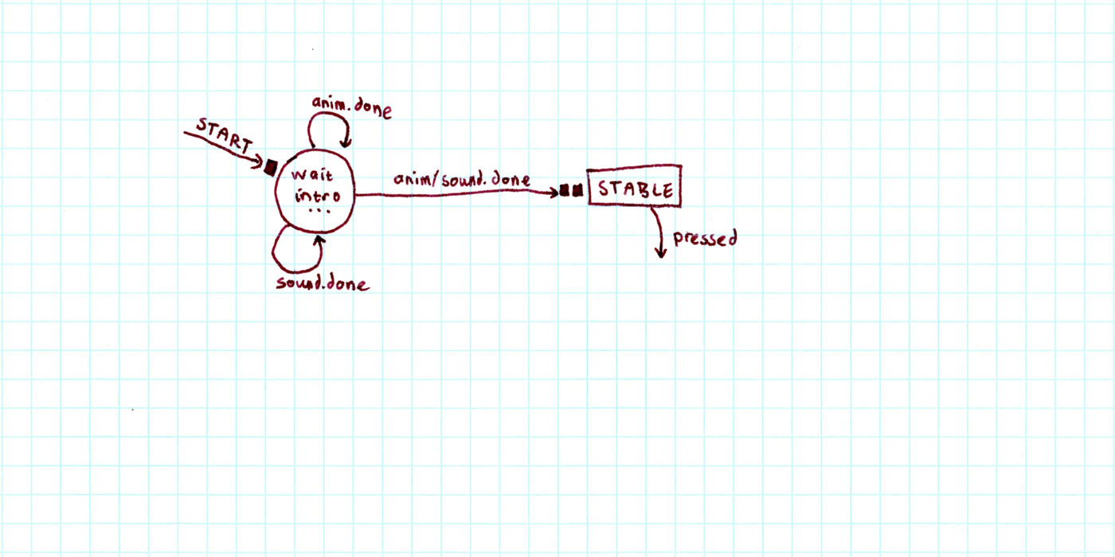
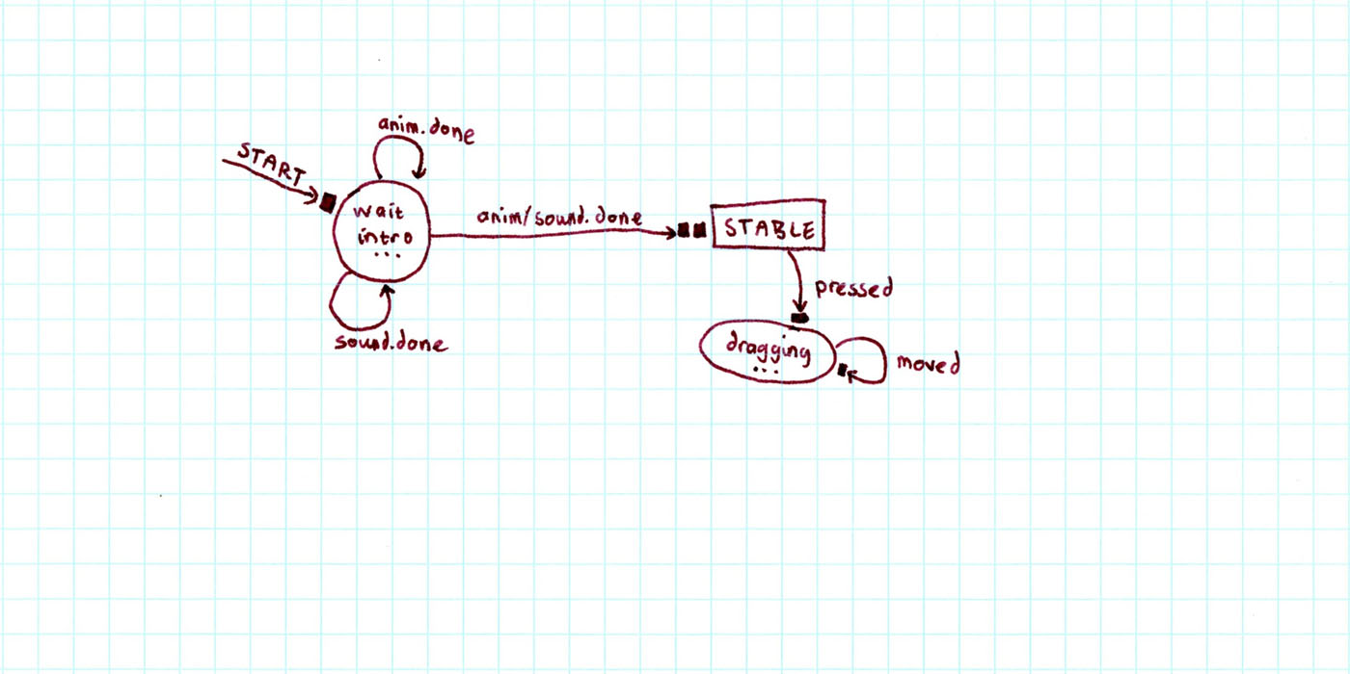
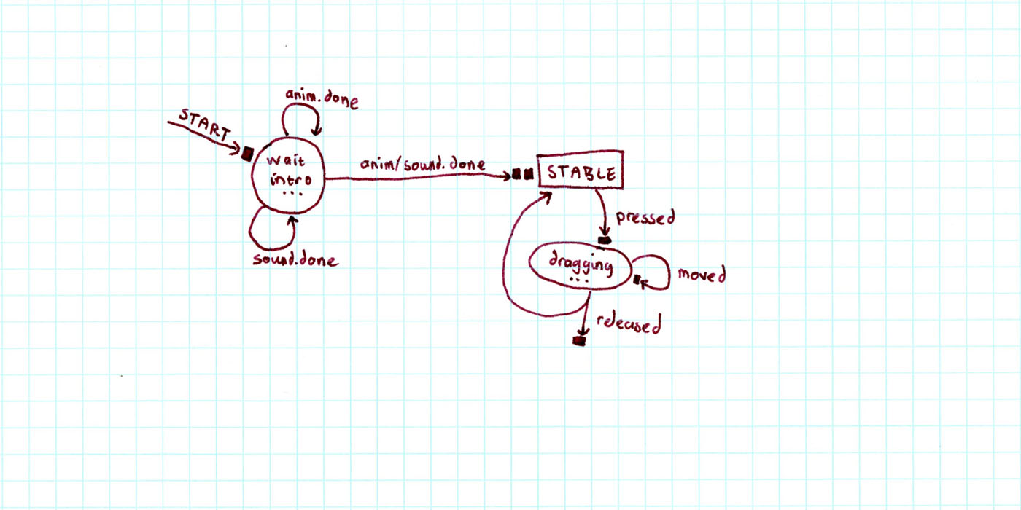
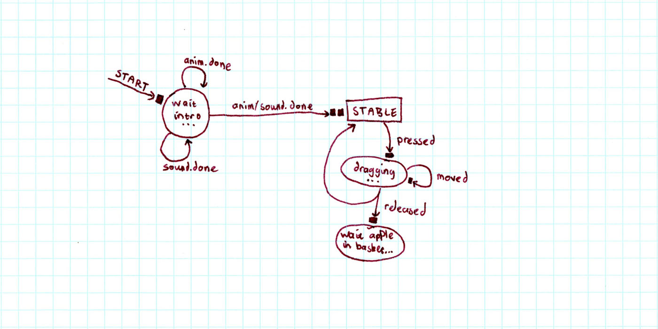
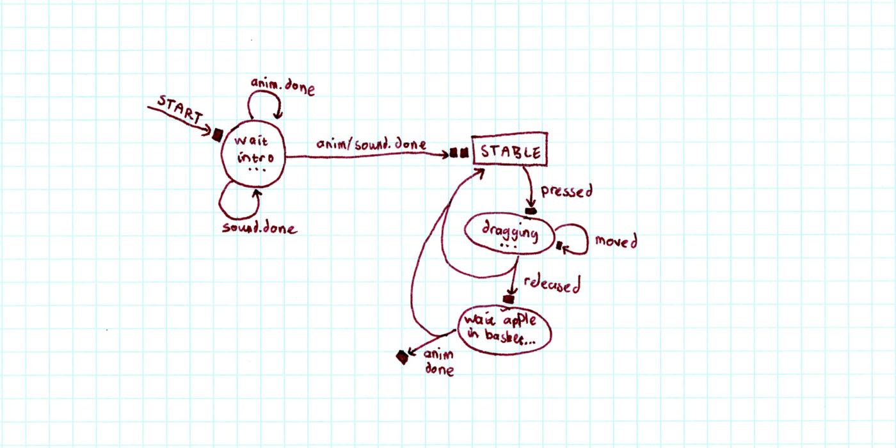
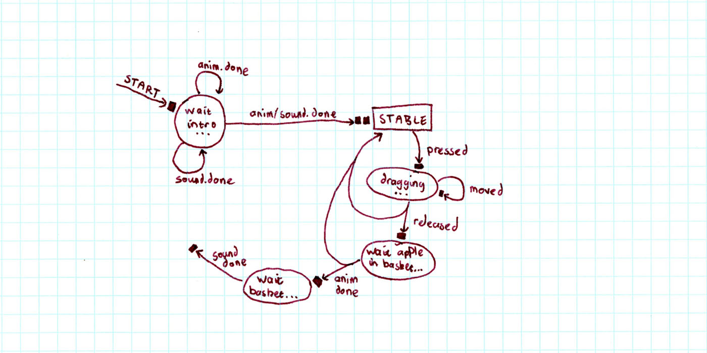
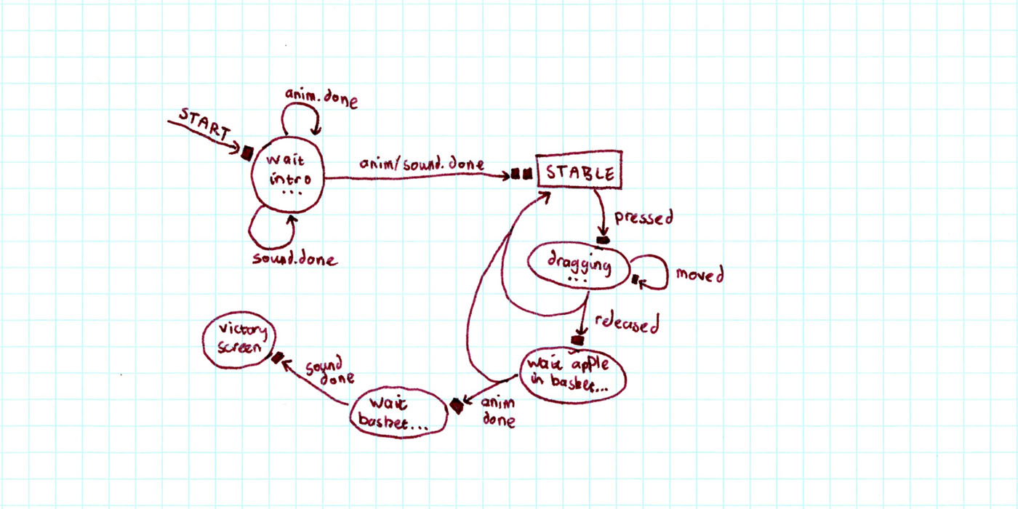
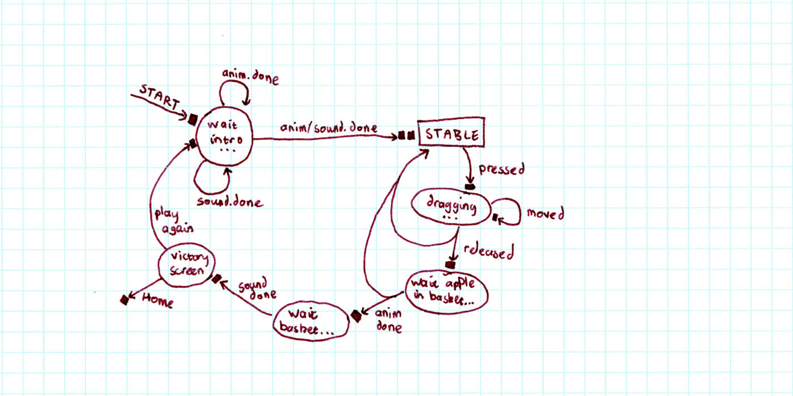
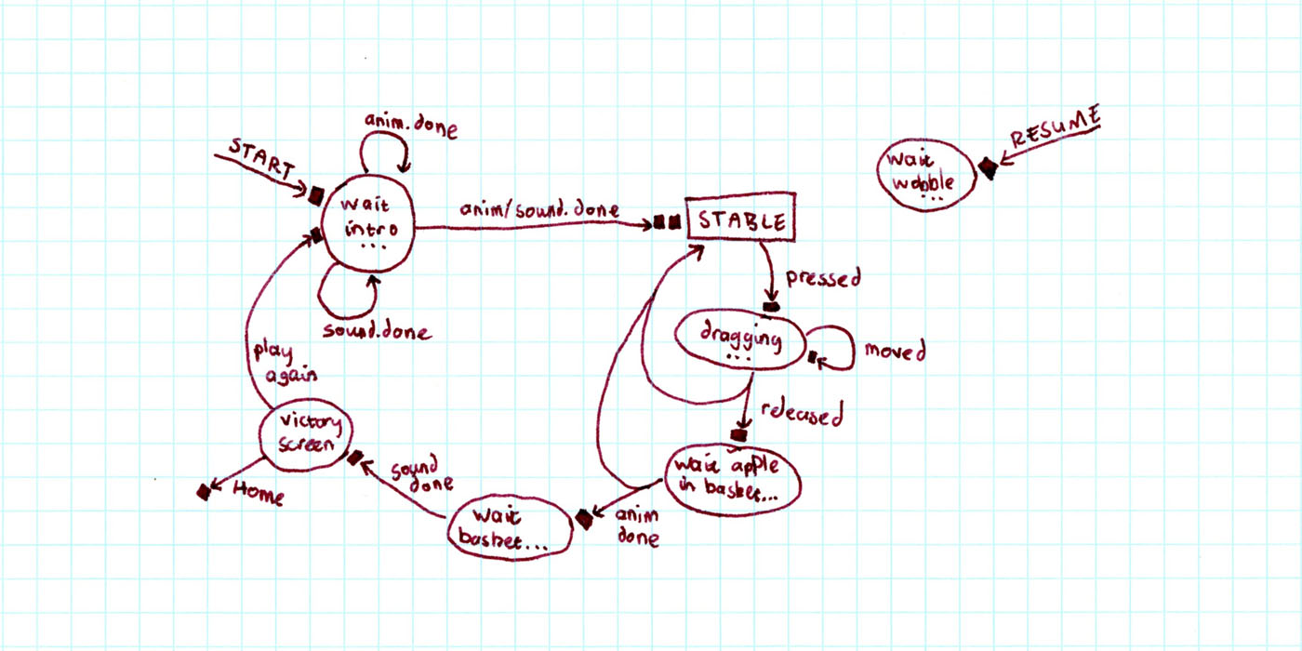
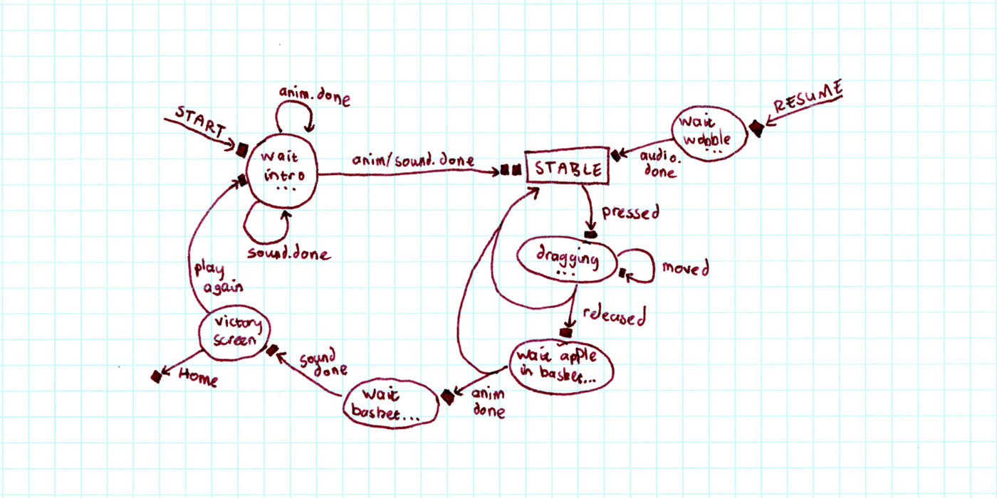
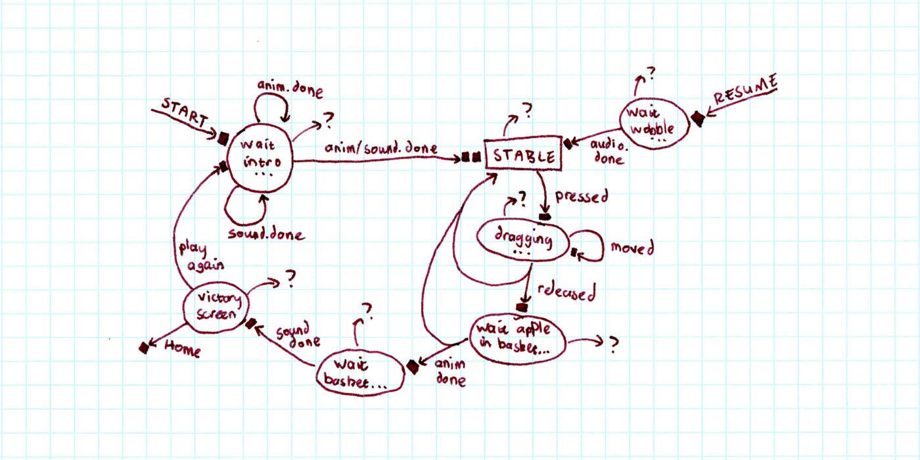
Event-based code...

Slide 24
The problem is events. They’re not going away.

Slide 25
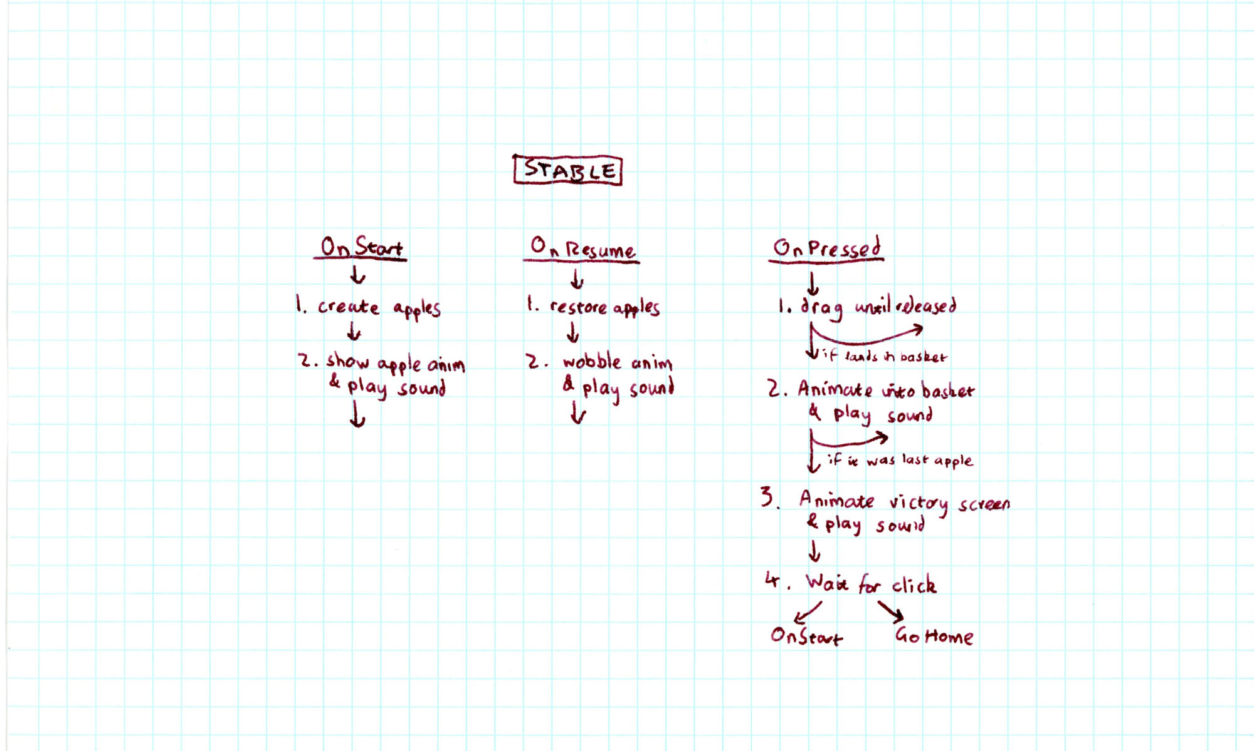
Async over events

Slide 26
Async over events
Protected Async Sub OnPointerPressed(e As PointerRoutedEventArgs)
' Let user drag the apple
Dim apple = CType(e.OriginalSource, Image)
Dim endpt = Await DragAsync(apple)
If Not BasketCatchmentArea.Bounds.Contains(endpt) Then Return
' Animate and sound for apple to whoosh into basket
Dim animateTask = AppleStoryboard.PlayAsync()
Dim soundTask = WhooshSound.PlayAsync()
Await Task.WhenAll(animateTask, soundTask)
If FreeApples.Count = 0 Then Return
' Show victory screen, and wait for user to click button
Await StartVictoryScreenAsync()
Await btnPlayAgain.WhenClicked()
OnStart()
End Sub

Slide 27
Async over events
' Usage: Await storyboard1.PlayAsync()
<Extension> Async Function PlayAsync(sb As Animation.Storyboard) As Task
Dim tcs As New TaskCompletionSource(Of Object)
Dim lambda As EventHandler(Of Object) = Sub() tcs.TrySetResult(Nothing)
Try
AddHandler sb.Completed, lambda
sb.Begin()
Await tcs.Task
Finally
RemoveHandler sb.Completed, lambda
End Try
End Function
// Usage: await storyboard1.PlayAsync();
public static async Task PlayAsync(this Storyboard storyboard)
{
var tcs = new TaskCompletionSource<object>();
EventHandler<object> lambda = (s,e) => tcs.TrySetResult(null);
try {
storyboard.Completed += lambda;
storyboard.Begin();
await tcs.Task;
}
finally {
storyboard.Completed -= lambda;
}
}

Slide 28
Async over events
// Usage: await button1.WhenClicked();
public static async Task WhenClicked(this Button button)
{
var tcs = new TaskCompletionSource<object>();
RoutedEventHandler lambda = (s,e) => tcs.TrySetResult(null);
try {
button.Click += lambda;
await tcs.Task;
}
finally {
button.Click -= lambda;
}
}

Slide 29
Async and RX
single
multiple
T | IEnumerable<T>
Task<T> | IObservable<T>
sync
async

Slide 30
Library Thinking

Slide 31
Be a responsible library developer
Library methods shouldn’t lie.
Be honest. Use “XxAsync” if, and only if, you’re not thread-bound (with a few notable exceptions).
Suffix should help caller to understand implementation.

Slide 32
Be a responsible library developer
Library methods shouldn’t lie.
Be honest. Use “XxAsync” if, and only if, you’re not thread-bound (with a few notable exceptions).
Suffix should help caller to understand implementation.
Library methods might be called from various environments.
Context becomes critical. Be agnostic whenever possible. ConfigureAwait(continueOnCapturedContext:false) is your best friend.

Slide 33
Be a responsible library developer
Library methods shouldn’t lie.
Be honest. Use “XxAsync” if, and only if, you’re not thread-bound (with a few notable exceptions).
Suffix should help caller to understand implementation.
Library methods might be called from various environments.
Context becomes critical. Be agnostic whenever possible. ConfigureAwait(continueOnCapturedContext:false) is your best friend.
Library methods might be used from perf-sensitive code.
Performance becomes critical.
Design for chunky instead of chatty.
Optimize the synchronously completing cases.

Slide 34
Common Problems

Slide 35

Symptom: Not Running Asynchronously
async void button1_Click(…) { Action work = CPUWork; await Task.Run(() => work()); … }
async void button1_Click(…) { Action work = CPUWork; await ScheduleAsync(work); … } async Task ScheduleAsync(Action work) { work(); }
Problem: Thinking ‘async’ forks.
Solution:
Use Task.Run around a synchronous method if you need to offload… but don’t expose public APIs like this.

Slide 36
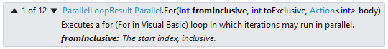

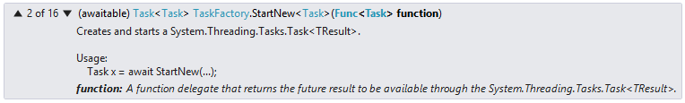
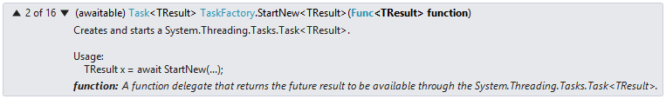
Symptom: Completing Too Quickly
…; Task.Delay(1000); …;
Problem: Neglecting to await.
Solution:
Await your awaitables.
…; await Task.Delay(1000); …;
Problem: Async void lambda.
Solution:
Use extreme caution (& knowledge) when passing around async lambdas as void-returning delegates.
Parallel.For(0, 10, async i => { await Task.Delay(1000); });
Problem: Task<Task> instead of Task.
Solution:
Make sure you’re unwrapping your Tasks, explicitly (Unwrap) or implicitly.
await Task.Run( async () => { await Task.Delay(1000); });
await Task.Factory.StartNew(
async () => { await Task.Delay(1000); });

Slide 37
Symptom: Method Not Completing
async void button1_Click(…) { await FooAsync(); } async Task FooAsync() { await Task.Delay(1000).ConfigureAwait(false); }
void button1_Click(…) { FooAsync().Wait(); } async Task FooAsync() { await Task.Delay(1000); }
async void button1_Click(…) { await FooAsync(); } async Task FooAsync() { await Task.Delay(1000); }
Problem: Deadlocking UI thread.
Solution:
Don’t synchronously wait on the UI thread.
Problem: Deadlocking UI thread.
Solution:
Use ConfigureAwait(false)
whenever possible.
var tcs = new TaskCompletionSource<T>(); Task.Run(delegate { T result = Foo(); tcs.SetResult(result); }); return tcs.Task;
var tcs = new TaskCompletionSource<T>(); Task.Run(delegate { try { T result = Foo(); tcs.SetResult(result); } catch(Exception e) { tcs.SetException(e); } }); return tcs.Task;
Problem: Awaited task never completes.
Solution:
Always complete Tasks when the underlying operation has ended. Always.

Slide 38
That’s a Wrap…

Slide 39
Key Takeaways
Understand why you’re “going async,” then code accordingly.
‘async’ doesn’t force asynchrony.
‘async void’ is only for top-level event handlers.
‘async’/’await’ are not magic.
‘async’/’await’ are about composition, not the leaves.
Implementing a library? Be kind to your consumers.

Slide 40
Follow-up Reading
Async/Await FAQ:
http://blogs.msdn.com/b/pfxteam/archive/2012/04/12/async-await-faq.aspx
Task-based Async Pattern:
http://aka.ms/tap
“Async over Sync” & “Sync over Async”:
http://blogs.msdn.com/b/pfxteam/archive/2012/03/24/10287244.aspx
http://blogs.msdn.com/b/pfxteam/archive/2012/04/13/10293638.aspx
Forking:
http://blogs.msdn.com/b/pfxteam/archive/2011/10/24/10229468.aspx
http://blogs.msdn.com/b/pfxteam/archive/2012/09/11/forking-in-async-methods.aspx
Common problems:
http://blogs.msdn.com/b/pfxteam/archive/2013/01/28/psychic-debugging-of-async-methods.aspx
http://blogs.msdn.com/b/pfxteam/archive/2012/02/08/10265476.aspx
http://blogs.msdn.com/b/pfxteam/archive/2011/10/02/10218999.aspx
http://blogs.msdn.com/b/pfxteam/archive/2012/04/12/10293249.aspx
http://blogs.msdn.com/b/pfxteam/archive/2011/01/13/10115163.aspx
Performance:
http://blogs.msdn.com/b/pfxteam/archive/2012/02/03/10263921.aspx
http://blogs.msdn.com/b/pfxteam/archive/2012/03/03/10277034.aspx
http://blogs.msdn.com/b/pfxteam/archive/2011/10/24/10229662.aspx
Await Anything
http://blogs.msdn.com/b/pfxteam/archive/2011/01/13/10115642.aspx
http://blogs.msdn.com/b/lucian/archive/2012/11/28/how-to-await-a-storyboard-and-other-things.aspx
http://blogs.msdn.com/b/lucian/archive/2012/11/28/how-to-await-a-button-click.aspx
WinRT & Async
http://blogs.msdn.com/b/windowsappdev/archive/2012/04/24/diving-deep-with-winrt-and-await.aspx
http://blogs.msdn.com/b/windowsappdev/archive/2012/06/14/exposing-net-tasks-as-winrt-asynchronous-operations.aspx
Parallel Patterns
http://www.microsoft.com/en-us/download/details.aspx?id=19222
http://msdn.microsoft.com/en-us/library/ff963553.aspx

Slide 41

© 2013 Microsoft Corporation. All rights reserved. Microsoft, Windows, Windows Vista and other product names are or may be registered trademarks and/or trademarks in the U.S. and/or other countries.
The information herein is for informational purposes only and represents the current view of Microsoft Corporation as of the date of this presentation. Because Microsoft must respond to changing market conditions, it should not be interpreted to be a commitment on the part of Microsoft, and Microsoft cannot guarantee the accuracy of any information provided after the date of this presentation. MICROSOFT MAKES NO WARRANTIES, EXPRESS, IMPLIED OR STATUTORY, AS TO THE INFORMATION IN THIS PRESENTATION.

